Slide 1
BT201
Biochemical Process Calculations
10/09/2022

Slide 2


Material balances for single unit with reaction
Stoichiometry
Indicates that for every two molecules (g-moles, lb-moles) of SO₂ that react, one molecule (g-mole, lb-mole) of O₂ reacts to produce two molecules (g-moles, lb-moles) of SO₃.
The numbers that precede the formulas for each species are the stoichiometric coefficients of the reaction components.
A valid stoichiometric equation must be balanced; that is, the number of atoms of each atomic species must be the same on both sides of the equation, since
The equation cannot be valid, for example, since it indicates that three atoms of atomic oxygen (O) are produced for every four atoms that enter into the reaction, for a net loss of one atom,

Slide 3
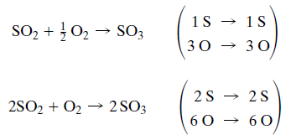
Balanced stoichimetry
are balanced

Slide 4


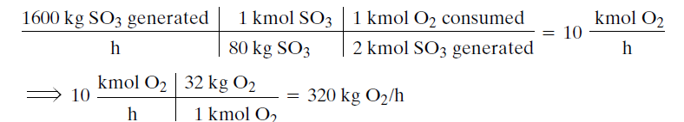
Stoichiometry ratio
The Stoichiometric ratio of two molecular species participating in a reaction is the ratio of their stoichiometric coefficients in the balanced reaction equation.
This ratio can be used as a conversion factor to calculate the amount of a particular reactant (or product) that was consumed (or produced), given a quantity of another reactant of product that participated in the reaction. For the reaction
We can write the stoichiometric ratios
If you know, for example, that 1600 kg/h of SO3 is to be produced, you can calculate the amount of oxygen required as

Slide 5

Limiting and excess reactant
Two reactants, A and B, are said to be present in stoichiometric proportion if the ratio (moles A present)/(mole B present) equals the stoichiometric ratio obtained from the balanced reaction equation.
For the reactants in the reaction
to be present in stoichiometric proportion, there must be 2 moles of SO2 for every mole of O2
(n_{SO2}/n_{O2}=2:1) present in the feed to the reactor
If reactants are fed to a chemical reactor in stoichiometric proportion and the reaction proceeds to completion, all of the reactants are consumed.
Example, if 200 mol of SO2 and 100 mol of O2 are initially present and the reaction proceeds to completion, the SO2 and O2 would disappear at the same instant.
It follows that if you start with 100 mol of O2 and less than 200 mol of SO2 (i.e., if the SO2 is present in less than its stoichiometric proportion), the SO2 would run out first, while if more than 200 mol of SO2 is initially present the O2 would run out

Slide 6
The reactant that would run out if a reaction proceeded to completion is called the limiting reactant, and the other reactants are termed excess reactants
A reactant is limiting if it is present in less than its stoichiometric proportion relative to every other reactant
If all reactants are present in stoichiometric proportion, then no reactant is limiting

Slide 7


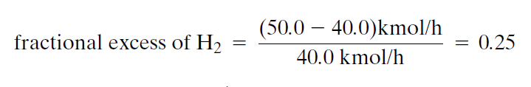
Suppose ( n_{A})_{feed} is the number of moles of an excess reactant, A, present in the feed to a reactor
(n_{A})_{Stoich} is the stoichiometric requirement
Consider, for example, the hydrogenation of acetylene to form ethane:
Suppose 20.0 kmol/h of acetylene and 50.0 kmol/h of hydrogen are fed to a reactor.
The stoichiometric ratio of hydrogen to acetylene is 2:1 (the ratio of coefficients in the stoichiometric equation), and since the ratio of H2 to C2H2 in the feed is 2.5:1 (50:20), hydrogen is fed in a greater-than-stoichiometric proportion to acetylene.
Acetylene is therefore the limiting reactant. Since it would take 40.0 kmol H2 to react completely with all the acetylene fed to the reactor,

Slide 8

Fractional conversion
Fractional conversion
If 80 moles of a reactant are fed and 70 moles react,
fractional conversion (f or x) = 70/80= 0.875

Slide 9
Considering the reaction:
Suppose 20.0 kmol of acetylene, 50.0 kmol of hydrogen, and 50.0 kmol of ethane are charged into a batch reactor.
Furthermore, suppose that after some time 30.0 kmol of hydrogen has reacted. How much of
each species will be present in the reactor at the moment?
Clearly, if you start with 50.0 kmol of H2 and 30.0 kmol reacts, you will be left with 20.0 kmol H2.
Also, if 30.0 kmol of H2 reacts, 15.0 kmol of C2H2 also reacts, leaving you with (20 -15) kmol 5.0 kmol C2H2.
Finally, the 30.0 kmol of H2 that reacts forms 15.0 kmol of C2H6 , which when added to the 50.0 kmol you started with gives you 65.0 kmol C2H6.

Slide 10

Extent of reaction
v_{i} to be the stoichiometric coefficient of the i^{th} species
negative for reactants and positive for products

Slide 11
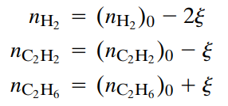
More generally, if 2ξ (kmol of H2 ) reacts (where 2 is the stoichiometric coefficient of H2), we may follow the same reasoning and write
Once you know how much hydrogen (or acetylene) reacts or how much ethane is formed, you can determine from one of these equations and then determine the remaining component amounts from the other two equations

Slide 12

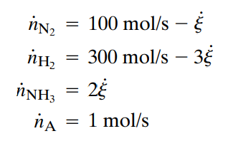
For example, consider the ammonia formation reaction:
Suppose the feed to a continuous reactor consists of 100 mol/s of nitrogen, 300 mol/s of hydrogen, and 1 mol/s of argon (an inert gas).
For a fractional hydrogen conversion of 0.60, calculate the outlet flow rate ammonia.
Extent of reaction: from hydrogen data, ξ=(300 x0.60)/3=60
Ammonia outlet: 2 x 60=120 mol/s

Slide 13

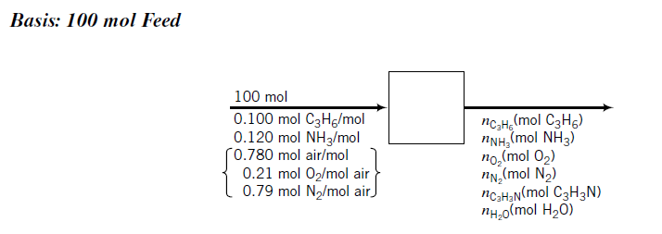
Acrylonitrile is produced in the reaction of propylene, ammonia, and oxygen:
The feed contains 10.0 mole% propylene, 12.0% ammonia, and 78.0% air. A fractional conversion
of 30.0% of the limiting reactant is achieved. Taking 100 mol of feed as a basis, determine
Which reactant is limiting
the percentage by which each of the other reactants is in excess, and
the molar amounts of all product gas constituents for a 30% conversion of the limiting reactant.

Slide 14
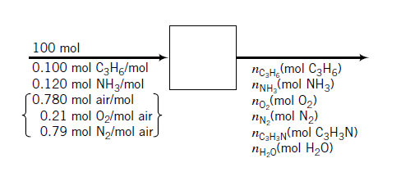
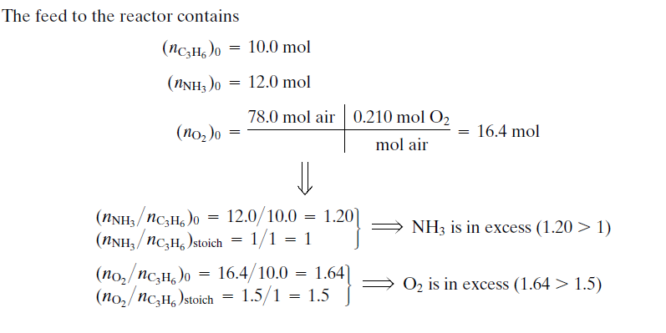
Since propylene is fed in less than stoichiometric proportion relative to the two other reactants propylene is the limiting reactant

Slide 15
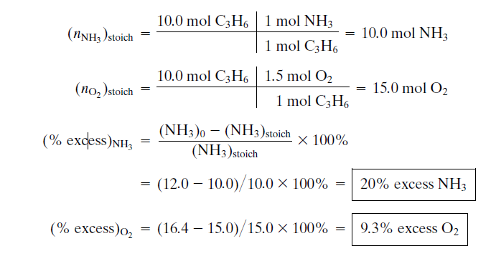

Slide 16
